Slide 1


HEALTHY LIFE PHARMACEUTICALS INC
PRESENTED BY JUMMAI BATNAH COHORT 24-05 SEPT 2024

Slide 2
TABLE OF CONTENTS
1. OVERVIEW
3. INSIGHTS AND RECOMMENDATIONS
2. OBJECTIVES
4.CONSTRAINTS/LIMITATION
5.CONCLUSIONS

Slide 3
Overview
Healthy Life Pharmaceuticals Inc. is a prominent player in the pharmaceutical industry, dedicated to developing and manufacturing innovative drugs and therapies that improve patient outcomes.
The company is known for its commitment to research and development, state-of-the-art manufacturing facilities, and a robust pipeline of products aimed at treating various chronic and acute medical conditions
.

Slide 4
OBJECTIVES
Enhanced Data Integration Unify fragmented data across departments for better decision-making.
Improved Operational Efficiency: Optimize production and streamline project execution.
Boost Market Competitiveness: Increase market share with innovative products and market trend leverage.
Enhanced Patient Outcomes: Focus on effective treatments for improved patient results.
Increase profitability through efficient resource allocation in marketing and R&D.

Slide 5
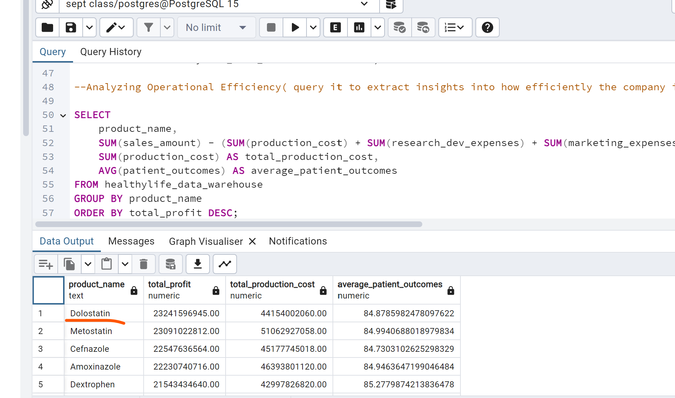
Insights and recommendations
1.Analyzing operational Efficiency

Slide 6

Insights
11. Dolostatin and metostatin have the highest profit margin.
2. The patient outcomes consistently demonstrate effectiveness across the products, ranging from 84 to 86.
3. Dextroprofen (86.03) and Claricillin (85.61) show the highest average outcomes, while Ibupromycin (84.48) and Acetophen (84.48) have the lowest.
4. There are wide variations in production costs, with Metostatin having the highest production cost ($51,062,927,058.00) while Amoxiphen has the lowest production cost

Slide 7

recommendations
Conduct a detailed analysis of the top-performing products to identify the factors contributing to their success. This could include formulation, dosage, patient demographics, and usage patterns.
For products with lower patient outcomes, develop targeted improvement plans. This could involve reformulating the product, adjusting dosages, or providing additional patient education to ensure proper usage.
Implement a system for regular monitoring of patient outcomes across all products. This will help quickly identify any issues and make necessary adjustments to maintain high standards of patient care.

Slide 8
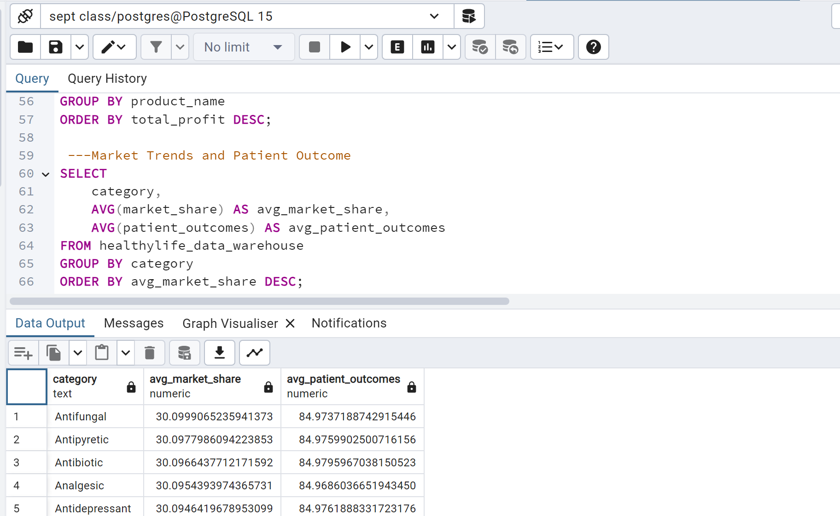
Insights and recommendations
2.Market Trends and Patient Outcome

Slide 9
Insights
Consistent Market Share: The average market share for all medication categories hovers around 30%, indicating a balanced distribution across these categories.
High Patient Outcomes: All categories show high average patient outcomes, above 84%, suggesting effective treatments across the board.
Minimal Variation: There is minimal variation in both market share and patient outcomes, which could imply a stable market and consistent treatment efficacy.

Slide 10

recommendations
Since the market share is evenly distributed, focus on differentiating products through unique selling points such as innovative delivery methods, patient convenience, or cost-effectiveness
Conduct further studies to understand the reasons behind the minimal variation in patient outcomes. This could uncover opportunities for improving treatment protocols or developing new, more
Given the high patient outcomes, healthcare providers should consider additional factors like side effects, patient preferences, and long-term benefits when prescribing medications.

Slide 11
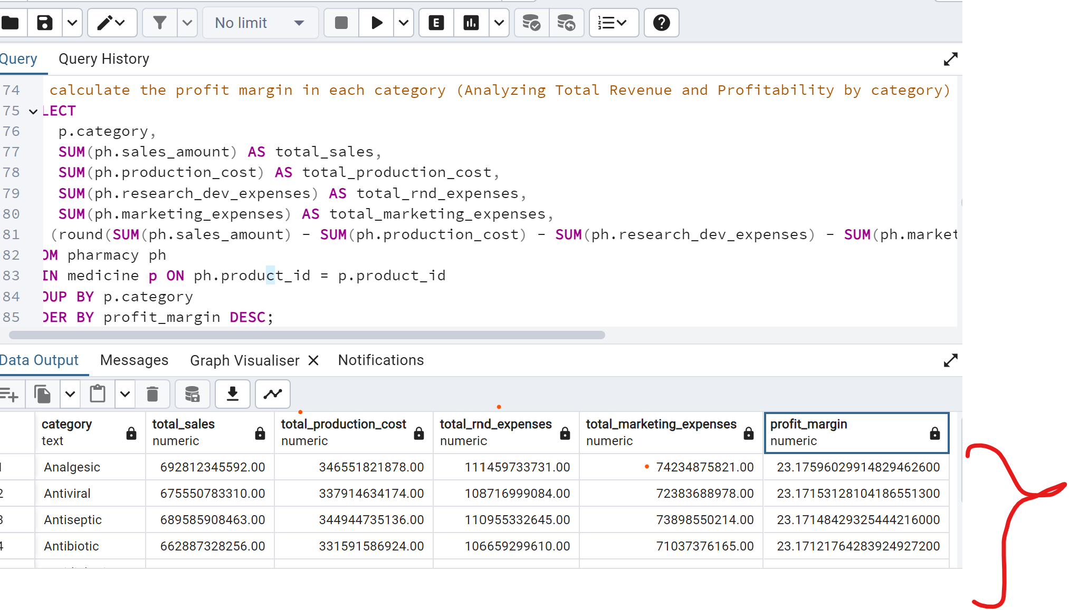
Insights and recommendations
3. Analyzing the profit margin in each category (Analyzing Total Revenue and Profitability by category)

Slide 12
Insights
Consistent Profit Margins: All categories have similar profit margins, around 23%, indicating stable profitability across different types of medications.
High Total Sales: Each category has total sales in the range of $660b to $700b, showing strong market performance.
Uniform R&D and Marketing Expenses: The R&D and marketing expenses are consistent across all categories, suggesting a balanced investment strategy.
Production Costs: The production costs are slightly higher for Analgesics and Antidepressants, which might be due to more complex manufacturing processes or higher demand.

Slide 13
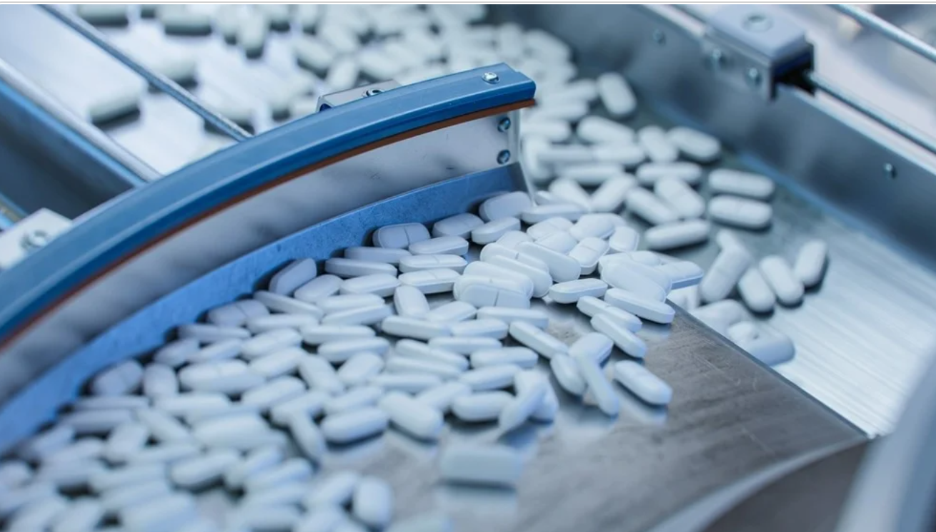
recommendations
Focus on reducing production costs for Analgesics and Antidepressants to improve profit margins further.
Evaluate the effectiveness of current marketing strategies and explore more cost-effective methods to maintain or boost sales given the uniform R&D expenses,
consider investing in innovative research to differentiate products and potentially increase market share
Develop targeted sales strategies for categories with slightly lower total sales, like Antibiotics and Antidiabetics, to enhance their market performance

Slide 14
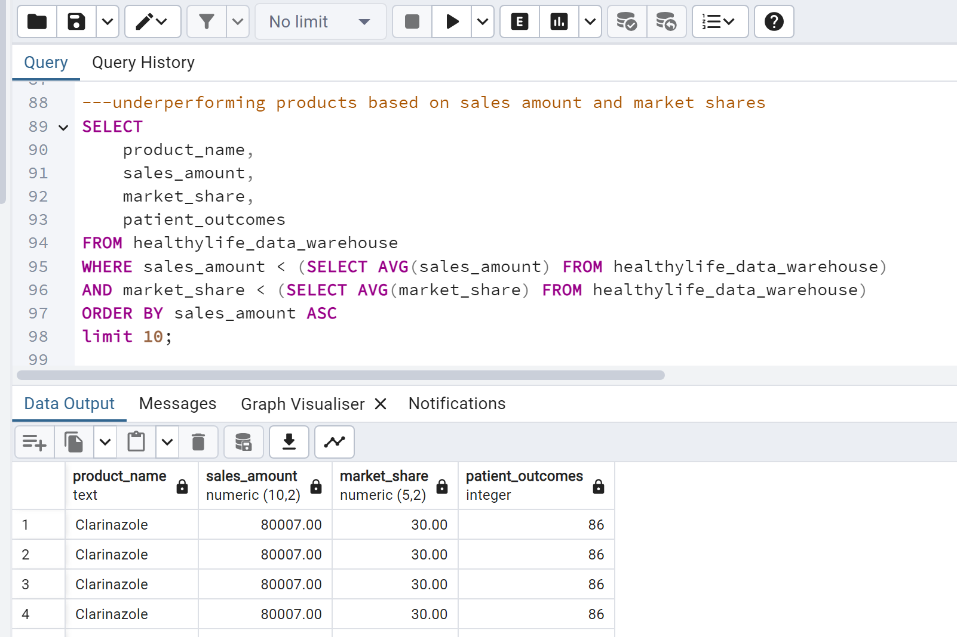
Insights and recommendations
4.Analyzing the Underperforming product

Slide 15

Insights
Consistent Performance: Clarinazole shows consistent performance across all metrics, with a sales amount of 80,007, a market share of 30%, and a patient outcome of 86. This indicates stability and reliability in its market segment.
High Patient Outcome: The patient outcome score of 86 suggests that Clarinazole is effective and well-received by patients, contributing to its steady market share.

Slide 16

recommendations
Expand Market Reach: Given the stable market share and high patient outcomes, consider expanding Clarinazole’s market reach through targeted marketing campaigns or entering new geographical markets.
Innovate and Differentiate: To further enhance its market position, invest in research and development to innovate and differentiate Clarinazole from competitors, potentially improving patient outcomes and increasing market share.

Slide 17
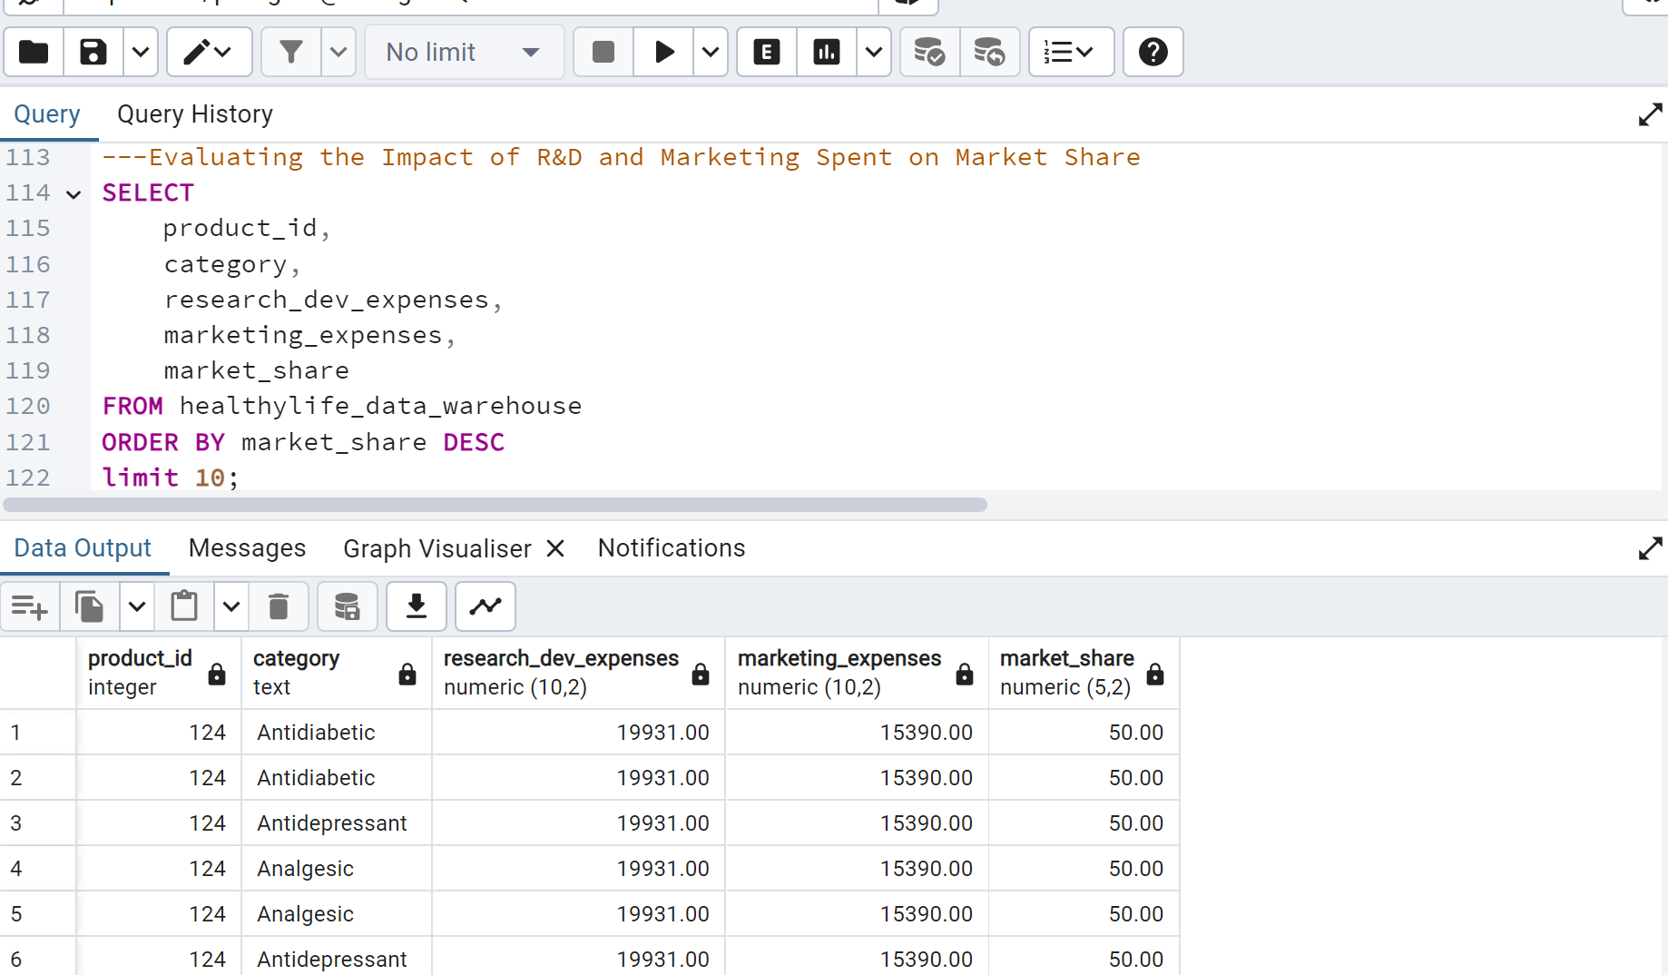
Insights and recommendations
5.Evaluating the Impact of R&D and Marketing Spent on Market Share

Slide 18

Insights
Uniform Investment: All categories have identical R&D and marketing expenses, suggesting a uniform investment strategy across different product types.
Consistent Market Share: Each product category holds a market share of 50%, indicating a balanced market presence or a potential duopoly.
Repetitive Data: The repetition of the same product ID and expenses across different categories might indicate either a data entry error or a standardized approach to budgeting.

Slide 19

recommendations
Data Verification: Verify the accuracy of the data to ensure there are no errors in recording identical R&D and marketing expenses for all categories.
Tailored Investment: Consider tailoring R&D and marketing investments based on the specific needs and performance of each category to optimize returns.
Market Analysis: Conduct a detailed market analysis to understand the competitive landscape and identify opportunities to increase market share beyond the current 50%.

Slide 20
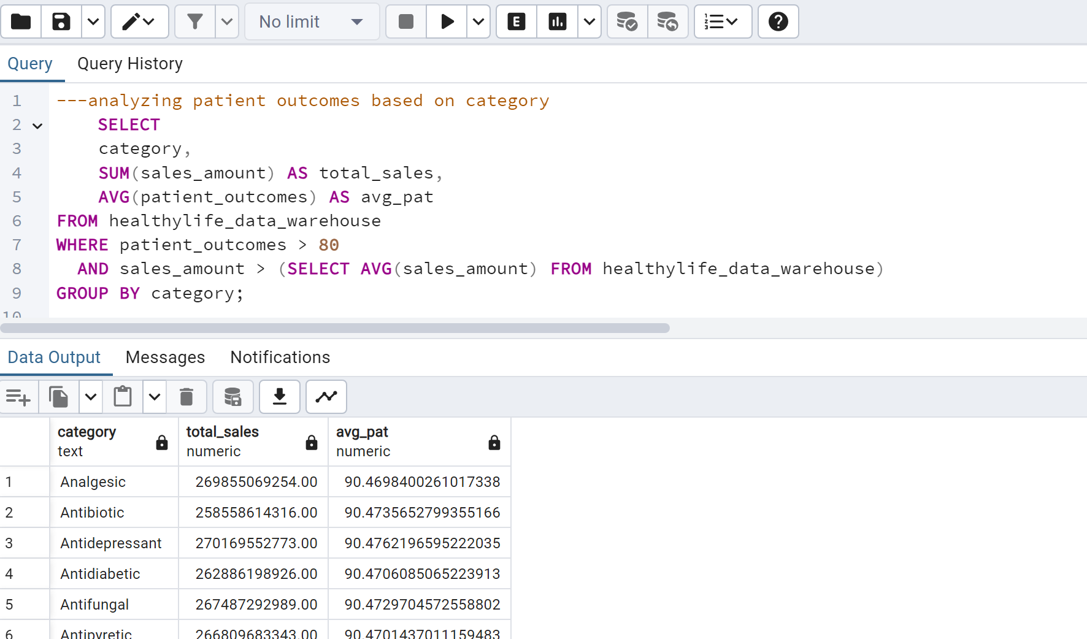
Insights and recommendations
6.Analyzing patient outcomes based on category

Slide 21
Insights
All categories have almost identical average patient numbers (90.47 or 90.48), indicating a uniform distribution in the usage of these medications among patients.
The antidepressant category has slightly higher total sales (2.7017 x 10^11) compared to other categories.
All categories have almost identical average patient numbers (90.47 or 90.48), indicating a uniform distribution in the usage of these medications among patients.

Slide 22
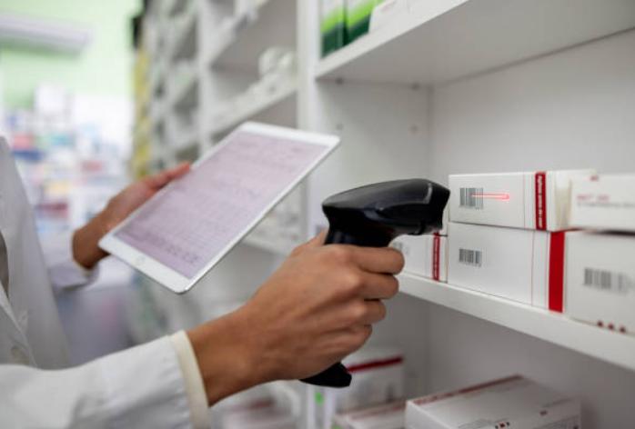
recommendations
Given that antidepressants have marginally higher sales figures than other categories, it may be beneficial to investigate the causes behind this increased demand.
Since the average number of patients per category is nearly identical, efforts could be made to understand if there are specific needs or gaps in treatment options within each category.
It may be useful to conduct further analysis on pricing strategies or marketing effectiveness

Slide 23
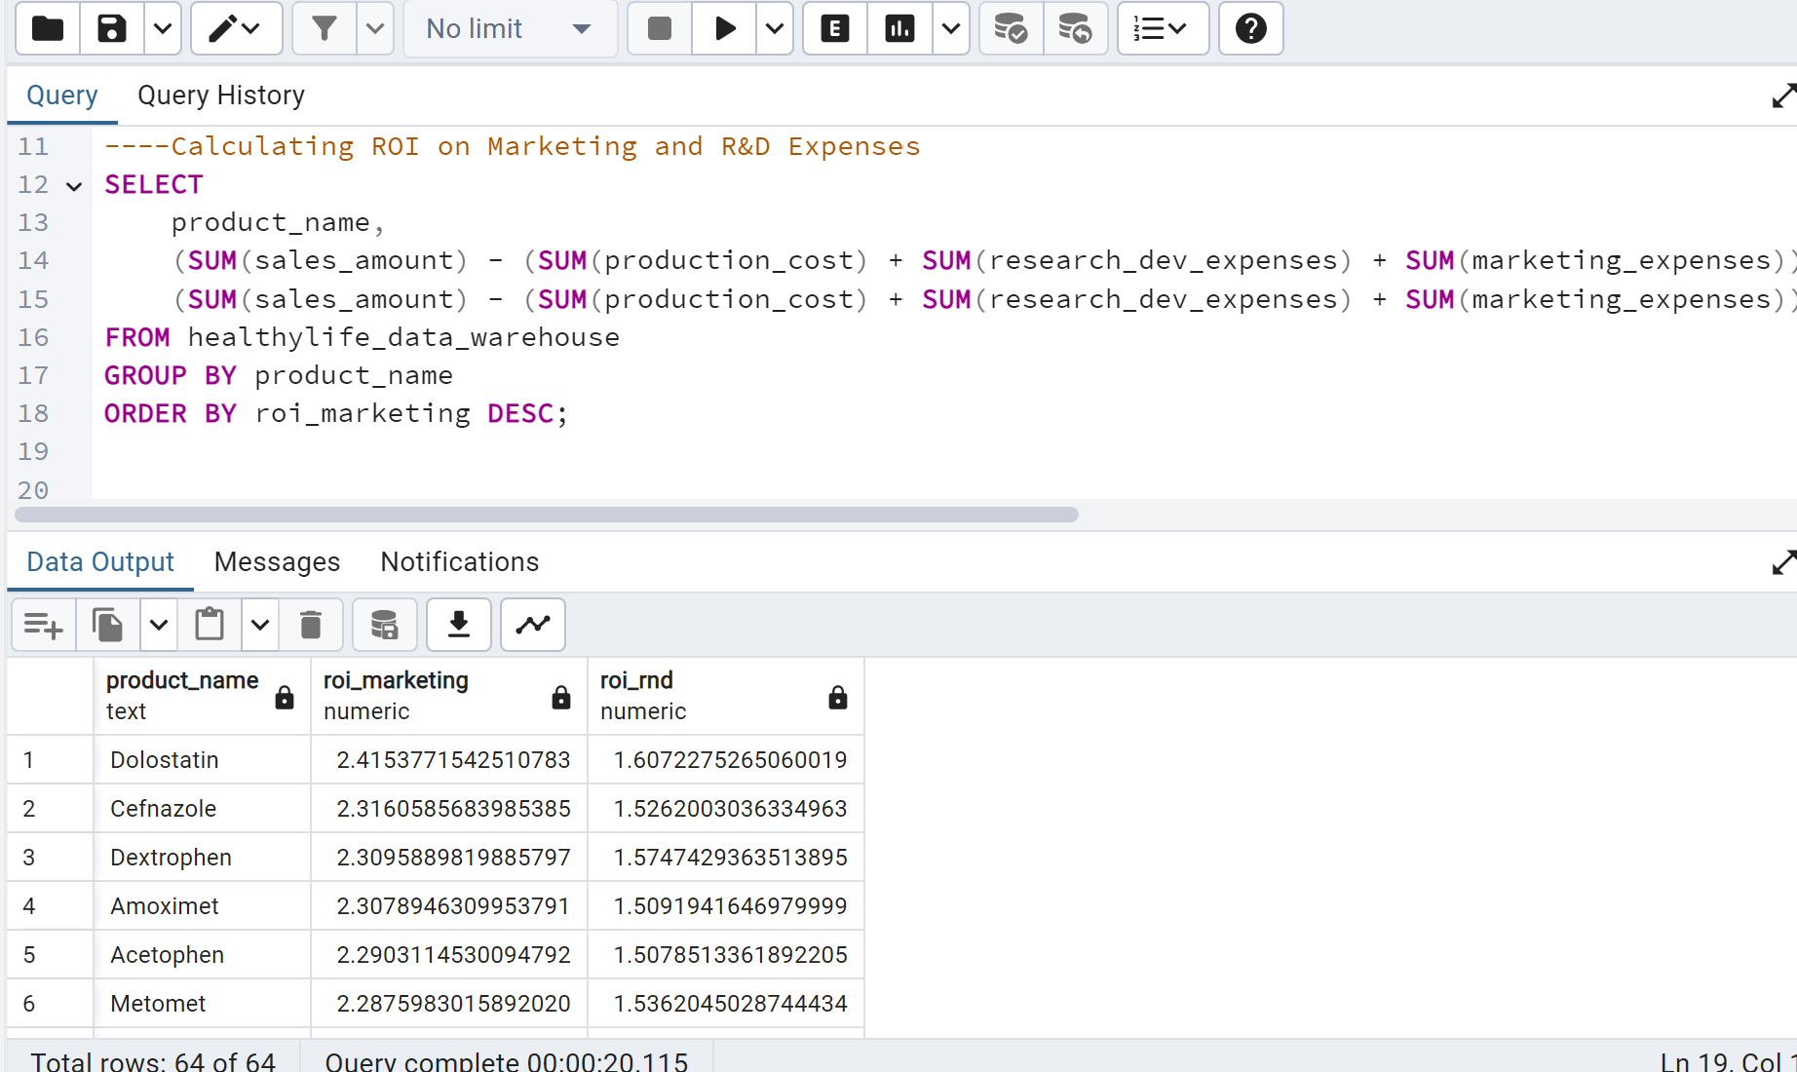
Insights and recommendations
7.Analyzing ROI on Marketing and R&D Expenses

Slide 24

Insights
Top Performers in Marketing ROI:
a.Dolostatin has the highest ROI in marketing at 2.42, indicating it is the most profitable product in terms of marketing investment.
b.Cefnazole and Dextrophen follow closely with marketing ROIs of 2.32 and 2.31, respectively.
Top Performers in R&D ROI:
a.Dextrophen has the highest ROI in R&D at 1.57, suggesting it yields the best returns on research and development investments.
b.Metomet and Dolostatin also show strong R&D ROIs at 1.54 and 1.61, respectively.
3Consistent Performers:
a.Dolostatin stands out as a consistent top performer in both marketing and R&D, making it a highly valuable product overall.

Slide 25

recommendations
Focus on high ROI products: prioritize marketing and R&D investments in Dolostatin, Cefnazole, and Dextrophen to maximize returns.
Consider reviewing low-performing products like Cefmet with low ROIs in marketing (2.00) and R&D (1.32) to understand reasons for poor performance and consider discontinuing or revising strategies for these products.
Optimize Budget Allocation:Analyze marketing and R&D ROIs for products like Amoximet and Acetophen to allocate budgets more effectively. For example, if a product has a high marketing ROI but a lower R&D ROI, consider increasing R&D investment to improve overall profitability.

Slide 26
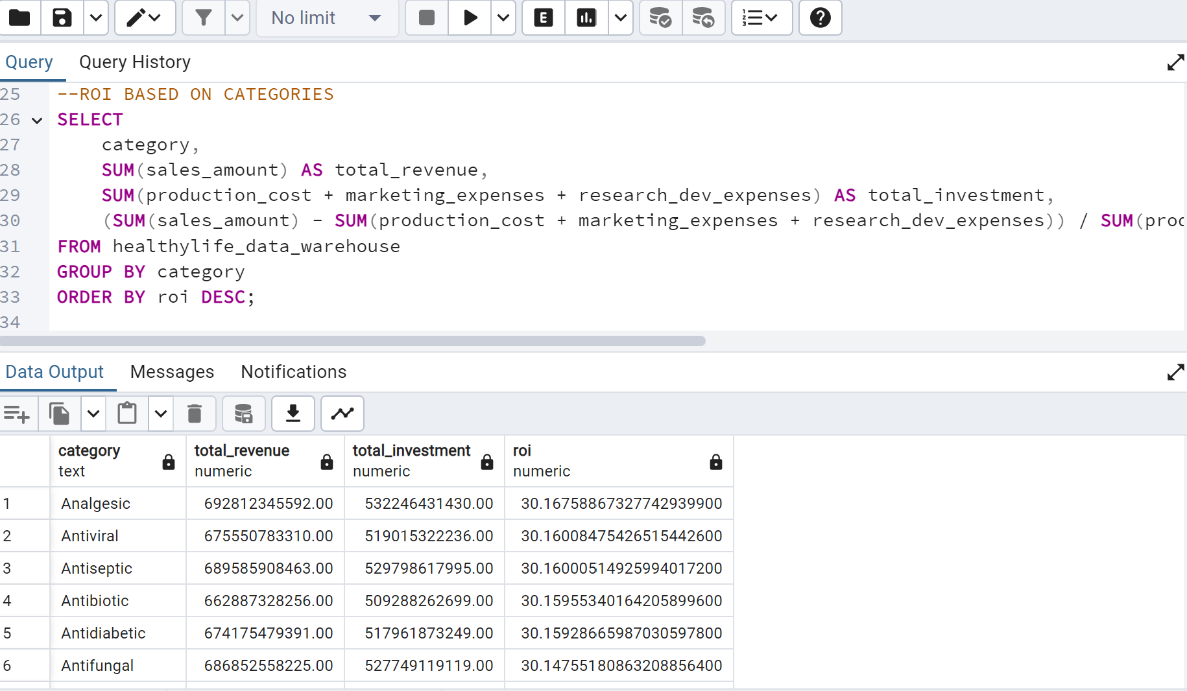
Insights and recommendations
8.ROI BASED ON CATEGORIES

Slide 27
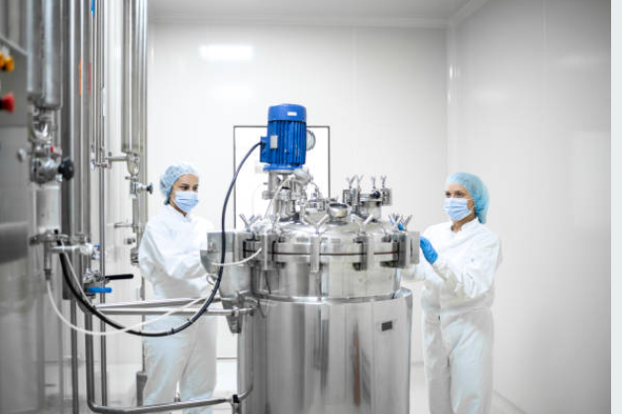
Insights
Consistent ROI Across Categories:
All categories have a very similar ROI, around 30.15%, indicating a consistent return on investment across different pharmaceutical sectors.
High Revenue and Investment:
Categories like Analgesic and Antidepressant have the highest total revenues and investments, suggesting they are major areas of focus and potentially high-demand markets.
Slight Variations in ROI:
Although the ROIs are similar, Analgesic has the highest ROI at 30.1676%, while Antipyretic has the lowest at 30.1315%, indicating slight variations in efficiency or profitability.

Slide 28

recommendations
Focus on High Revenue Categories:
Prioritize investments in categories like Analgesic and Antidepressant to maximize returns, as they already generate high revenues and have strong ROIs.
Investigate Lower ROI Categories:
Conduct a detailed analysis of categories like Antipyretic and Antifungal to identify areas for improvement, as they have slightly lower ROIs compared to others.
Optimize Operational Efficiencies:
Explore ways to enhance operational efficiencies across all categories to push the ROI even higher, given the already consistent performance.

Slide 29
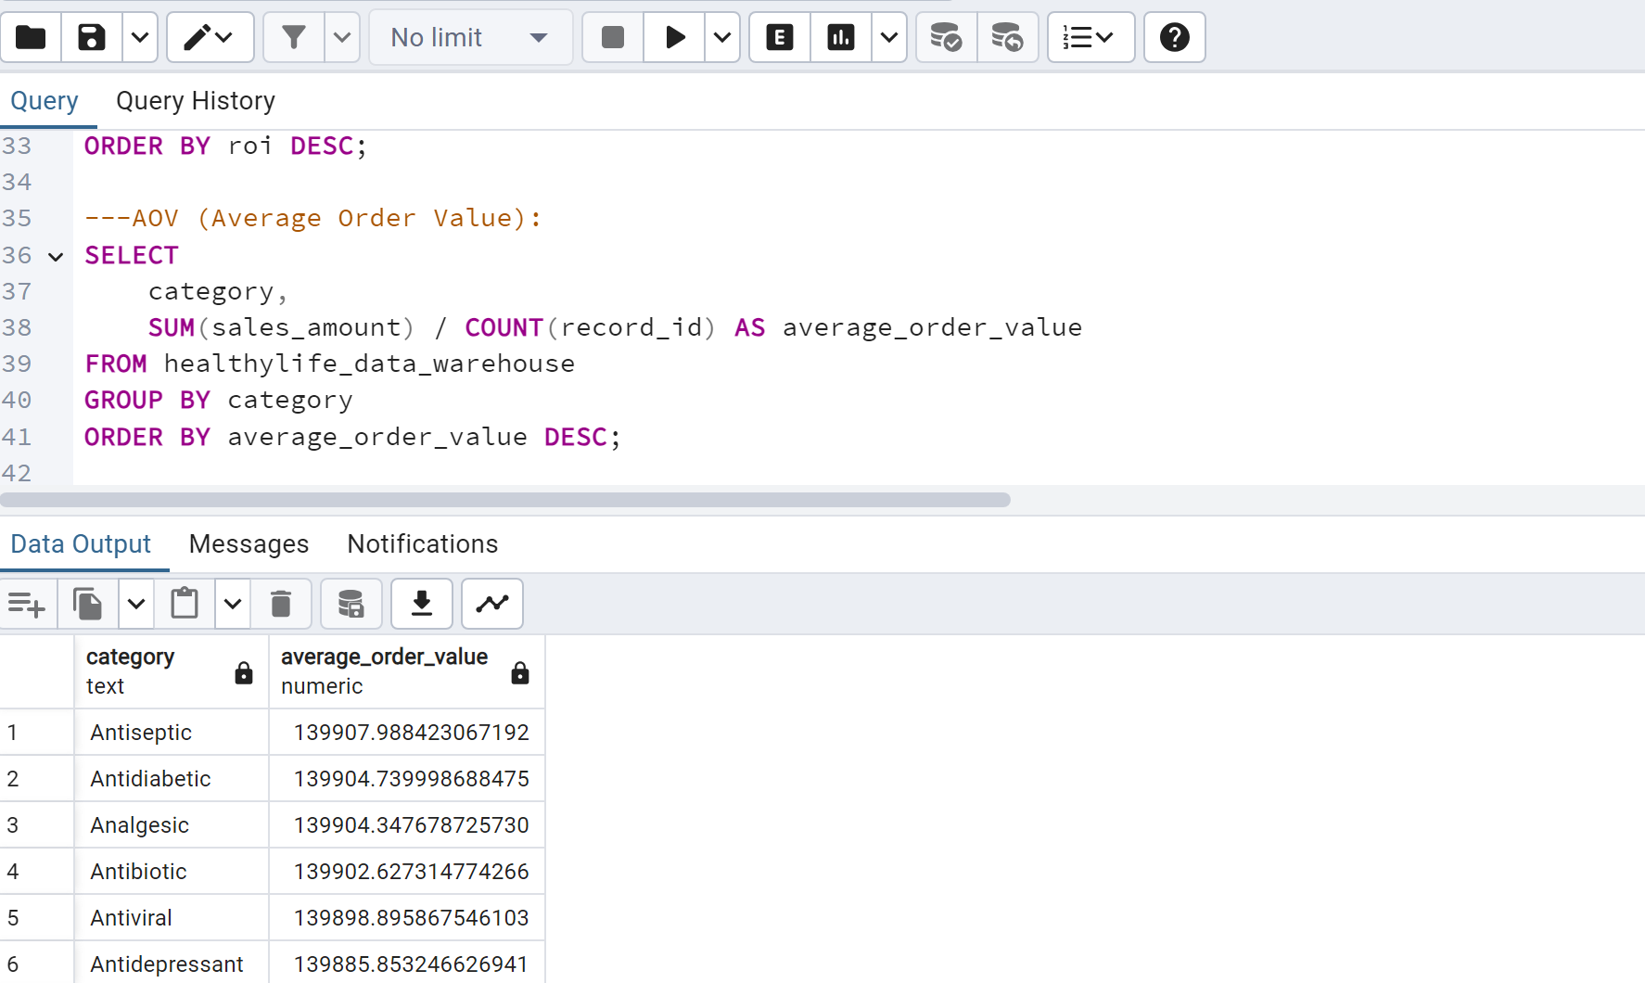
Insights and recommendations
9.AOV (Average Order Value)

Slide 30
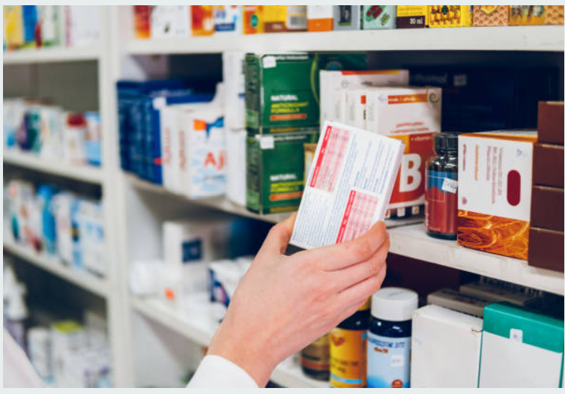
Insights
Highest Average Order Value:
The Antiseptic category has the highest average order value at 139,907.9884, indicating it might be a high-demand or high-priced category.
Close Range of Values:
The average order values for all categories are very close, ranging from 139,879.1035 to 139,907.9884, suggesting a uniform pricing or ordering strategy across different categories.
Lowest Average Order Value:
The Antifungal category has the lowest average order value at 139,879.1035, which could imply lower demand or lower pricing compared to other categories.

Slide 31
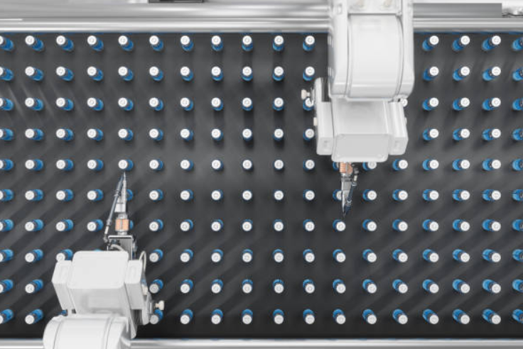
recommendations
Leverage High-Value Categories:
Focus marketing and sales efforts on the Antiseptic category to capitalize on its high average order value. This could involve targeted promotions or expanding the product range within this category.
Review Pricing Strategies:
Given the close range of average order values, consider reviewing and possibly adjusting pricing strategies to ensure competitiveness and maximize profitability across all categories.
Boost Lower-Value Categories:
Investigate the reasons behind the lower average order value for the Antifungal category. This could involve market research to understand demand, adjusting pricing, or enhancing product offerings to increase its attractiveness.

Slide 32
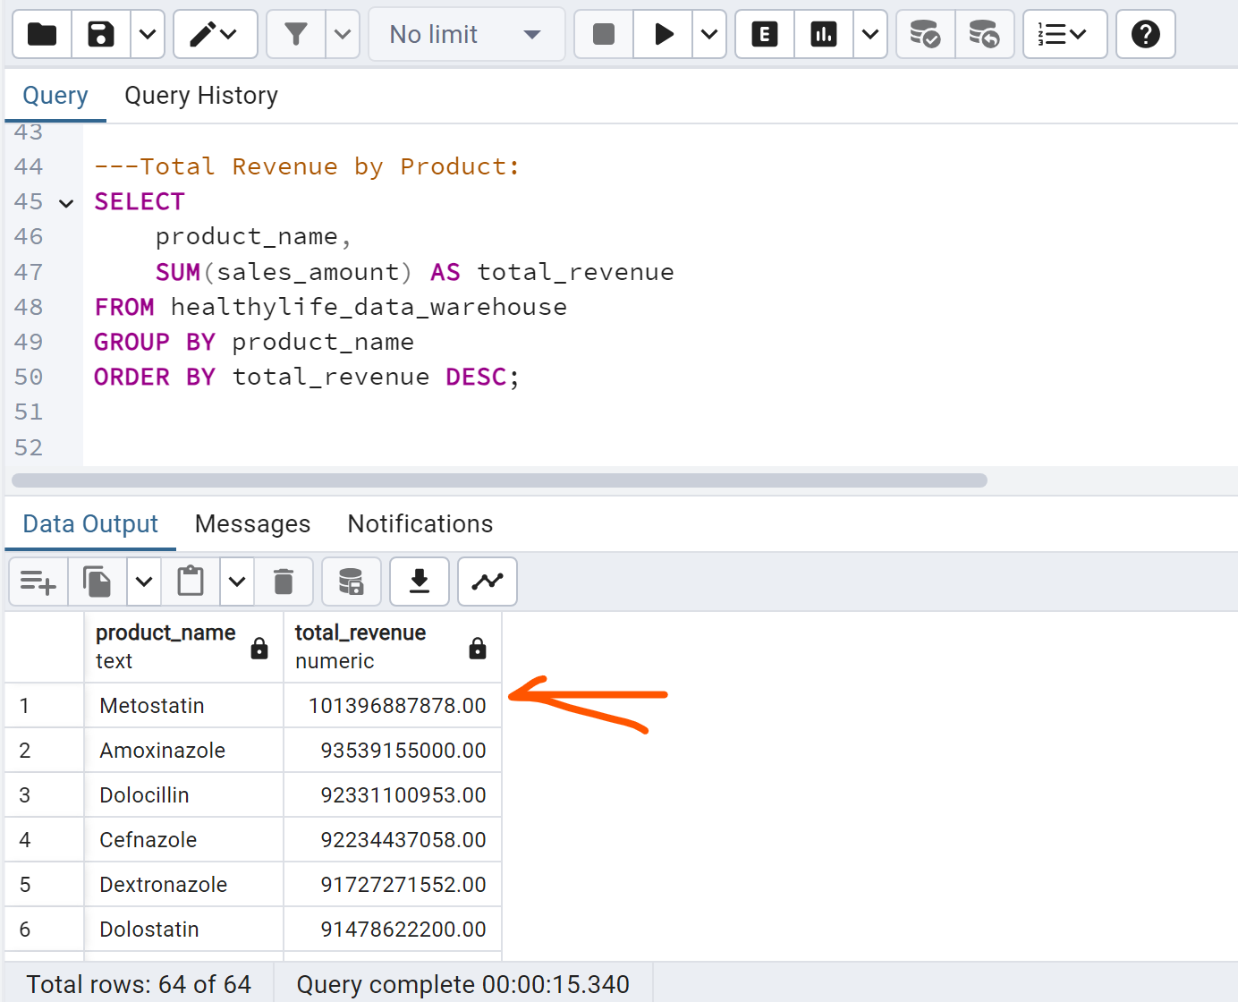
Insights and recommendations
10.Total Revenue by Product

Slide 33

Insights
Top Revenue Generator:
Metostatin is the highest revenue-generating product with approximately $101.397 billion, indicating it is a major contributor to overall sales.
Revenue Distribution:
There is a significant range in total revenues, with the top product, Metostatin, generating over $100 billion, while the lowest, Amoxiphen, generates around $72.74 billion. This indicates a wide disparity in product performance.
Cluster of High Performers:
Products like Amoxinazole, Dolocillin, and Cefnazole also show strong performance, each generating over $90 billion in revenue, suggesting they are key products in the portfolio.

Slide 34

recommendations
Focus on High Performers:
Continue to invest in and support top-performing products like Metostatin, Amoxinazole, and Dolocillin to maintain and potentially increase their market share.
Analyze Underperformers:
Investigate why lower-revenue products like Metovir and Amoxiphen are underperforming. This could involve market research to understand demand, potential rebranding, or pricing adjustments.
Diversify and Innovate:
Explore opportunities to diversify the product portfolio by developing new products or improving existing ones. Innovation in lower-performing categories could help boost overall revenue.

Slide 35
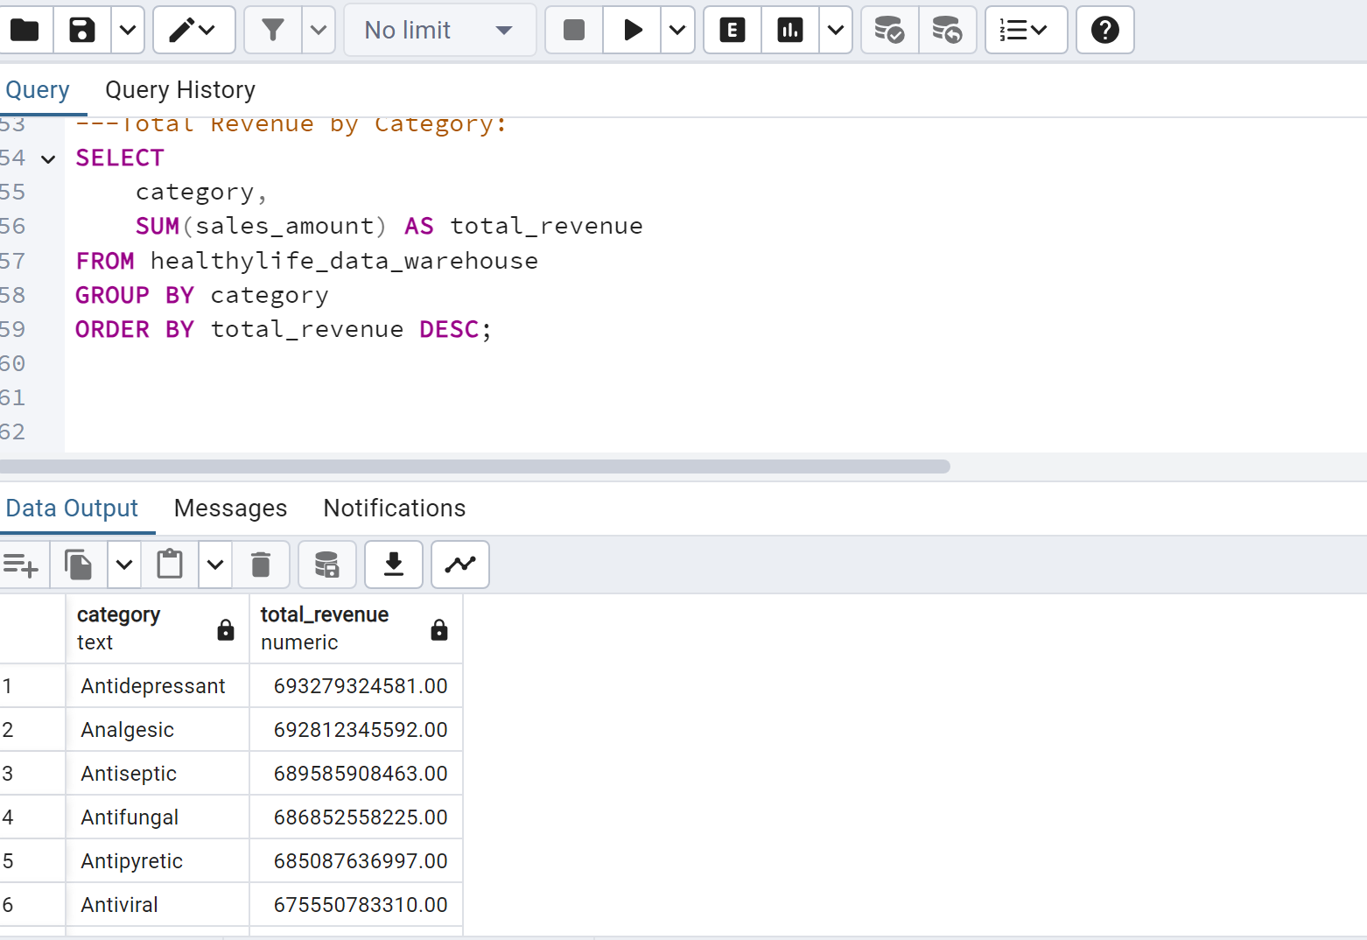
Insights and recommendations
11.Total Revenue by Category

Slide 36
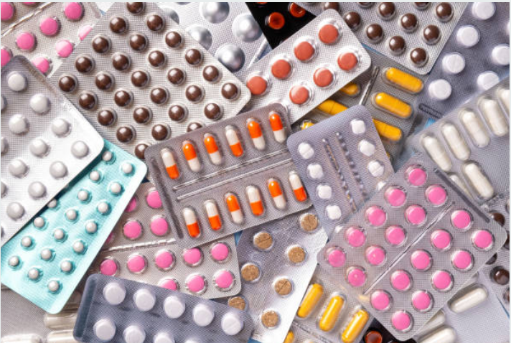
Insights
Top Revenue Category:
Antidepressants lead in total revenue with approximately $693.279 billion, indicating a high market demand or effective pricing strategy.
Close Revenue Range:
The total revenues for all categories are relatively close, ranging from $662.887 billion (Antibiotics) to $693.279 billion (Antidepressants), suggesting a balanced distribution of sales across different medication types.
Lower Revenue Category:
Antibiotics have the lowest total revenue among the listed categories, which could indicate lower usage rates or competitive pricing affecting revenues.

Slide 37

recommendations
Invest in High Revenue Categories:
Focus on further developing and marketing Antidepressants and Analgesics to capitalize on their strong revenue performance.
Enhance Lower Revenue Categories:
Investigate the reasons behind the lower revenue for Antibiotics and consider strategies such as diversifying product offerings, improving marketing efforts, or adjusting pricing to boost sales.
Maintain a Diverse Portfolio:
Given the substantial revenues across all categories, continue to maintain a diverse product portfolio to mitigate risks and ensure steady income streams.

Slide 38
limitations/CONSTRAINTS
Breakdown by Region or Customer Segment: Analyze how different regions or customer segments contribute to overall profitability and whether some segments are more profitable.
Historical Performance Analysis: Track how profit margins have evolved to assess the long-term sustainability of different categories.
Constraint: The analysis focuses on a specific year (2023). However, the company's financial performance could vary by quarter or month.

Slide 39
conclusions
HealthyLife Pharmaceuticals maintains healthy profit margins across most categories. The company has effectively controlled its production, marketing, and R&D costs, leading to consistently high levels of profitability.
Investing in product quality and effectiveness has a positive impact on profitability, showing a likely link between patient outcomes and profit margins.
There is a consistently high revenue generation, particularly in categories like Antidepressants and Analgesics, indicating a strong market presence and demand for these types of medications.
Some categories and products have lower revenues, presenting opportunities for targeted improvements through enhanced marketing, pricing adjustments, or product development.

Slide 40
THANK YOU

